Slide 1

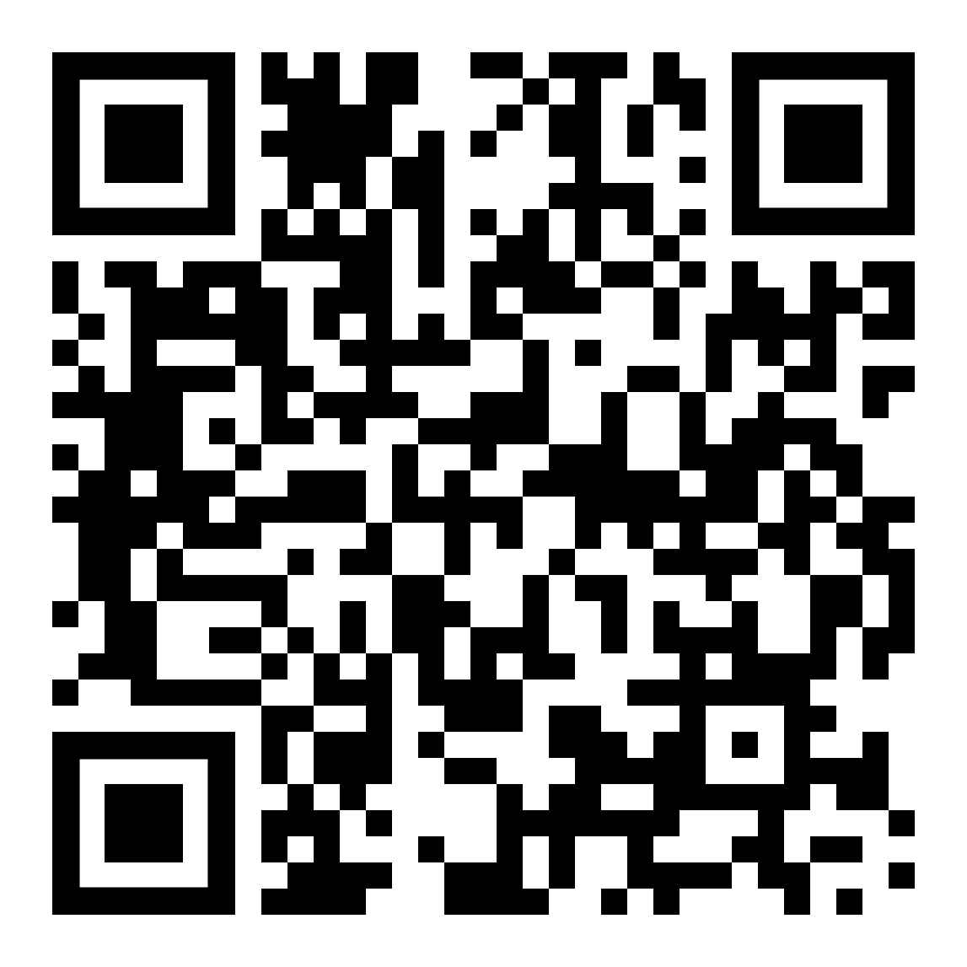
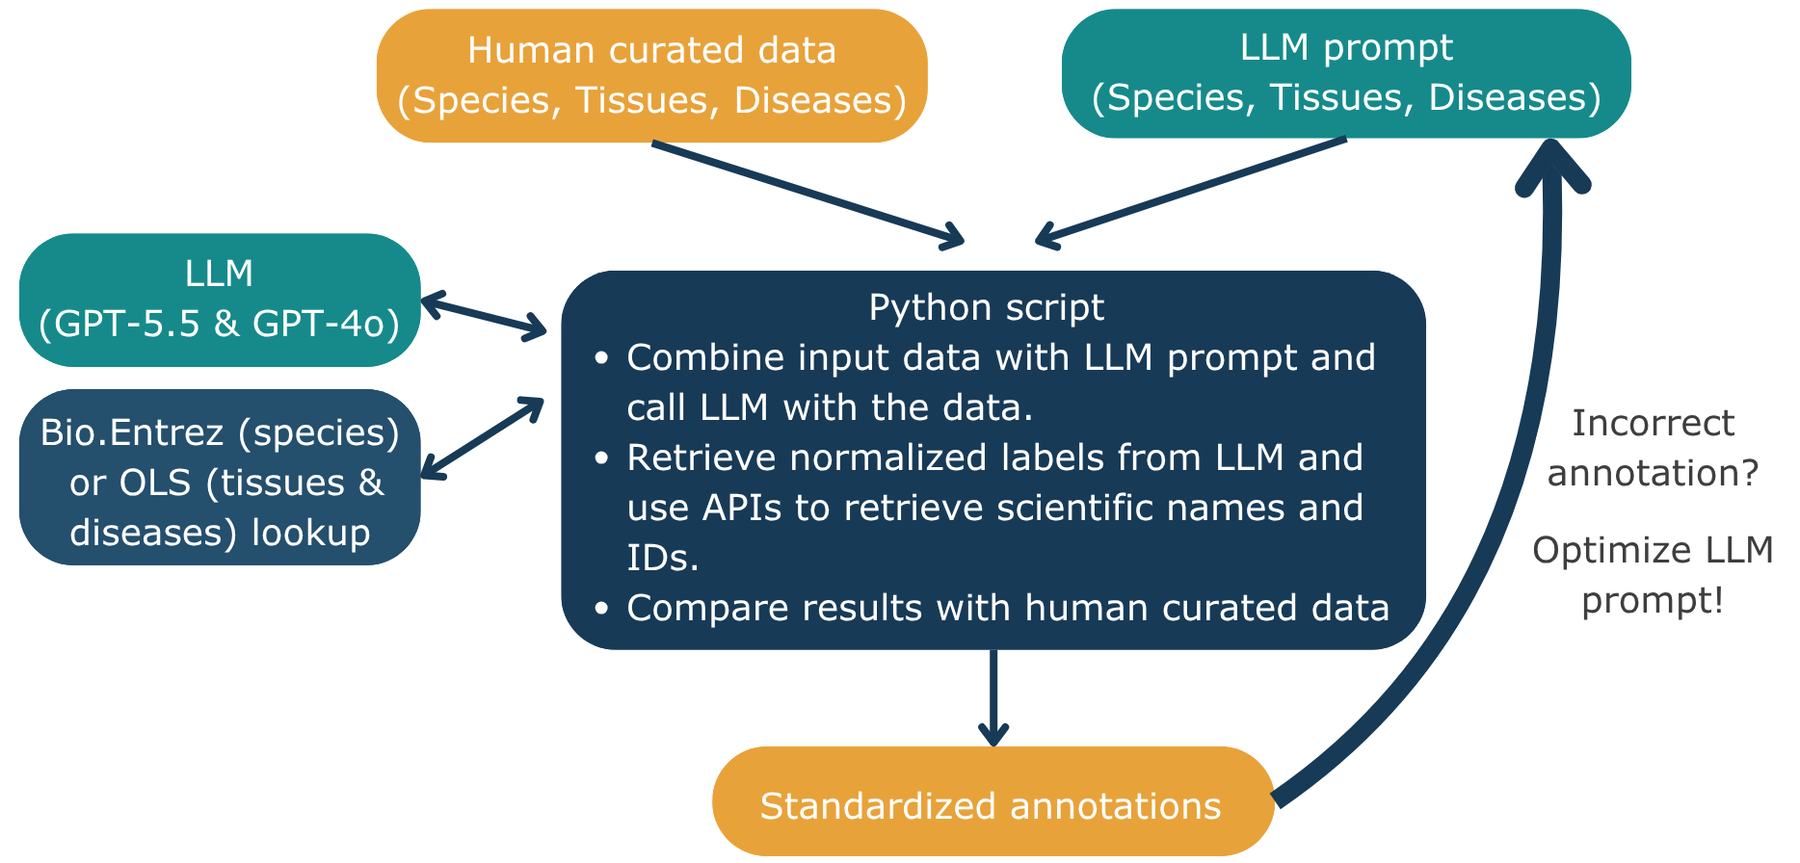
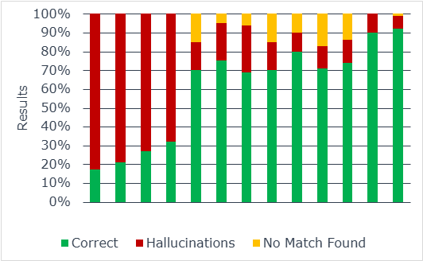
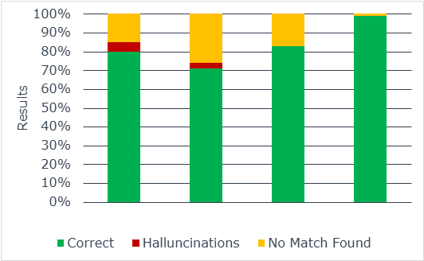
GlyGen AI-Assisted Biocuration
Species, Tissue, and Disease Annotation
Taylor DiMenna¹, Shashank Kesineni^{2,3}, Luis Jimenez⁴, Rene Ranzinger⁵, Urnisha Bhuiyan¹, Raja Mazumder¹
¹ George Washington University, USA; ² Rock Ridge High School, USA; ³ Academics of Loudoun (AET IT), USA; ⁴ Universidad Católica de Santa María, Peru; ⁵ University of Georgia, USA
INTRODUCTION
PROJECT WORKFLOW
SPECIES RESULTS
Prompt iterations over time
Legacy biological datasets often contain unstructured free-text labels, including abbreviations, misspellings, informal terms, and outdated names. Because biological definitions and nomenclature change over time, these labels do not always map directly to current reference identifiers. This complicates integration with modern databases and risks losing scientific knowledge captured in legacy records.
MULTIPLE LEGACY LABELS
STANDARDIZED ANNOTATION
GPT-5.5
GPT-4o
GPT-5.5
human
H. sapiens
Homo sapiens
patient
Homo sapiens
NCBI Taxonomy ID: 9606
Correct Hallucinations No Match Found
Figure 1. Results from dataset with species that needed to be mapped manually
Prompt iterations over time
Normalization links name variants to one reference record.
PROMPT ENGINEERING
HYPOTHESIS
BASELINE
OBSERVE
REVISE
VALIDATE
Can an LLM-assisted workflow normalize legacy biological labels and improve mapping accuracy to current reference identifiers through iterative prompt refinement?
Start with simple instructions.
Review results and compare with the curated metadata.
Edit the LLM prompt.
Re-run and re-compare with curated metadata.
KEY LESSONS LEARNED
Before
Prompt Optimization
After
OBJECTIVES
Give the LLM a role.
Keep prompt concise.
Use direct language.
Be consistent.
Ordered procedure section.
Force “No Match Found”.
Optimize for no hallucinations.
Add correct/failure examples.
salmonella bareilly
Salmonella enterica
Salmonella bareilly
Salmonella enterica subsp. enterica serovar Bareilly
GPT-4o
GPT-5.5
1
Normalize
Correct Hallucinations No Match Found
Convert variable legacy labels into standardized biological names using an LLM.
Figure 2. Results from dataset with species that did not need to be mapped manually
2
Map
RESULTS EXPLAINED
Link normalized names to identifiers from NCBI Taxonomy, UBERON, or Disease Ontology.
Prompt refinement improved identification
Type of GPT model used effected result quality
GPT-5.5 used initially
Switched to GPT-4o during prompt development and iterative optimization for cost saving
Final evaluation using GPT-5.5
DISCUSSION
3
Evaluate
Difficult species names involving synonyms, outdated nomenclature, and taxonomic ambiguity were more challenging than direct matches. These names were previously mapped manually and therefore located in Figure 1.
Model choice affected output quality, highlighting the importance of evaluating model selection and prompt design.
To minimize token costs, GPT-4o was utilized during prompt engineering, whereas GPT-5.5 was used to generate the initial and final results.
Hallucinations remain a concern, as LLMs may return plausible but incorrect scientific names or taxonomic assignments.
Conservative matching prioritizes precision over recall: returning “No Match Found” avoids unsupported mappings but may leave valid matches unresolved.
Curator review remains essential to verify biological meaning, resolve ambiguous cases, and confirm identifier accuracy.
Compare automated mappings with curator-verified references and measure how prompt changes affect accuracy.
FUTURE WORK
Extend strategy and workflow for tissue and disease labels using own prompt optimizations.
Continue to quantify the effects of prompt refinement on mapping accuracy.
Test optimized prompts with different LLMs including smaller and free models.
Use optimized prompts for mapping user provided labels to dictionary terms in data submission platforms such as GlyTableMaker.
WHY IT MATTERS
Faster conversion of legacy free-text records.
Preserves scientific meaning as biological nomenclature changes.
Consistent links to reference databases and ontologies.

